Slide 1
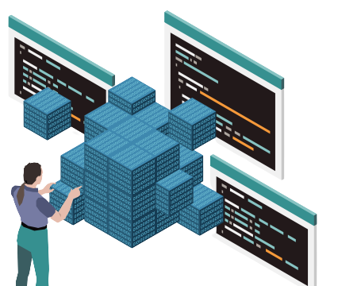

Object Oriented Programming

Slide 2

WHAT……………….?
OBJECT-ORIENTED PROGRAMMING (OOP) is a programming paradigm that attempts to design and build computer programs the same way people think about and deal with the world. ​
An object-oriented program may be considered a collection of interacting objects. Each object is capable of sending and receiving messages, and processing data.​

Slide 3

WHY
Object-Oriented Programming (OOP) is used because it offers several benefits over other programming paradigms. Some of the major advantages of using OOP are:
Modularity
Reusability
Security
Flexibility
Scalability

Slide 4
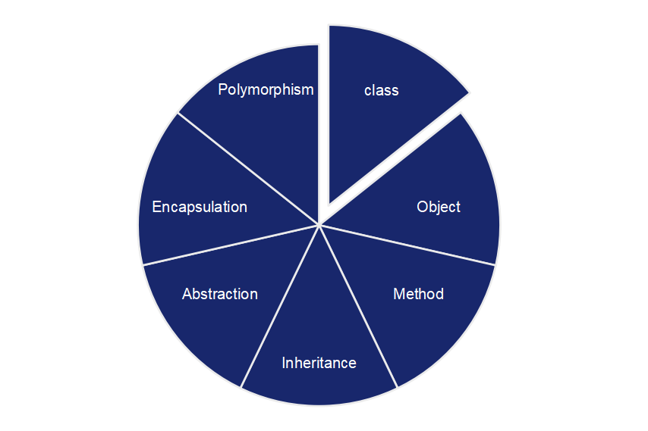
OOP's Concepts

Slide 5

Class
A class is the blueprint from which the individual objects are created.
A class defines the characteristics of an object
It includes Attributes (its fields or properties) and the things it can do ( methods, operations or features).

Slide 6

Example :
class
Job
Attributes
Methods
Title
Company
Salary
Responsibilities
Requirements
Apply
Interview
Accept Offer
Resign

Slide 7
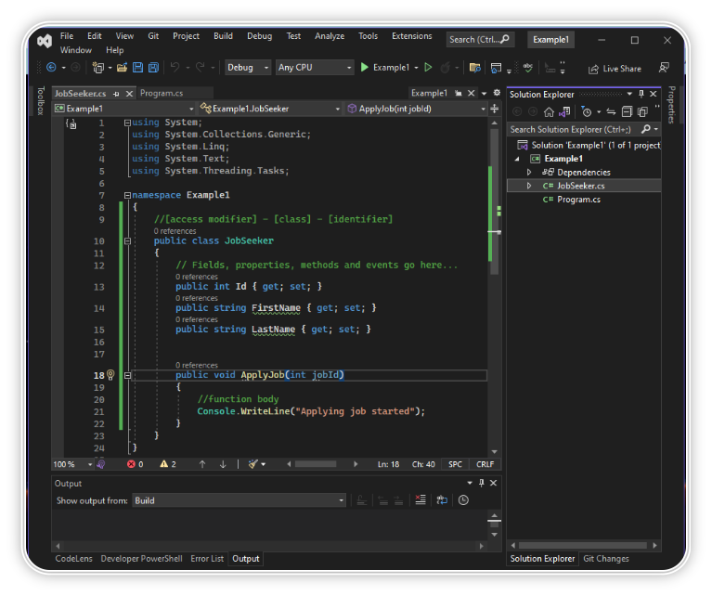
EXAMPLE :

Slide 8
Object
Objects are entities that have behavior , that hold information, and that can interact with one another.
In pure OOP terms an object is an instance of a class.

Slide 9
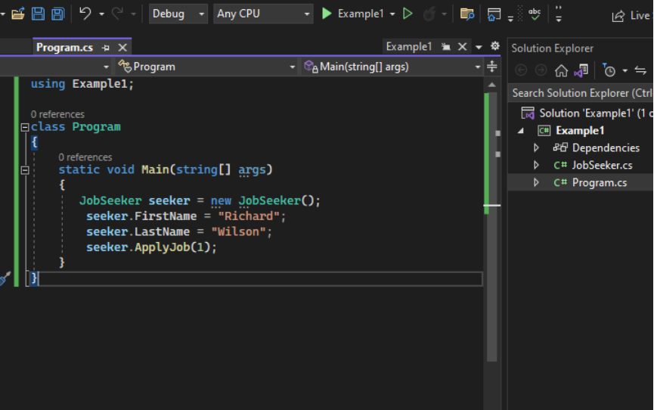
EXAMPLE :
In C#, objects are created using the "new" keyword followed by the name of the class to be instantiated.
Syntax :-
Class name object name =new constructor();

Slide 10

Inheritance
Inheritance can be defined as the process where one object acquires the properties of another.
A subclass(child) is a specialized version of a class, which inherits attributes and behaviors from the parent class
A child may also have additional unique behaviors and properties of its own that its parent does not have.

Slide 11
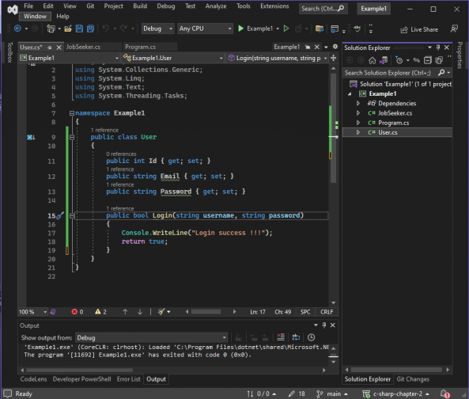
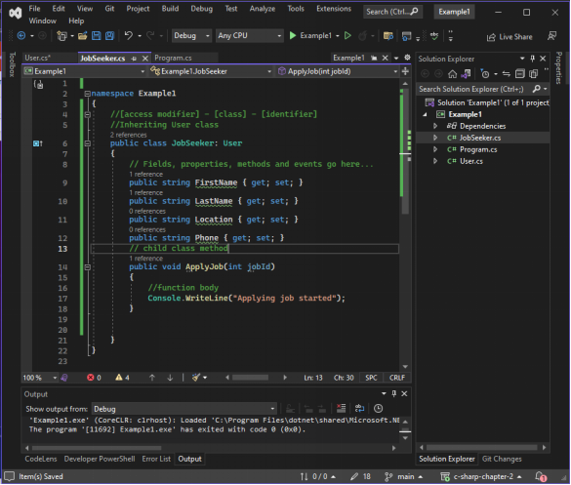
EXAMPLE :

Slide 12
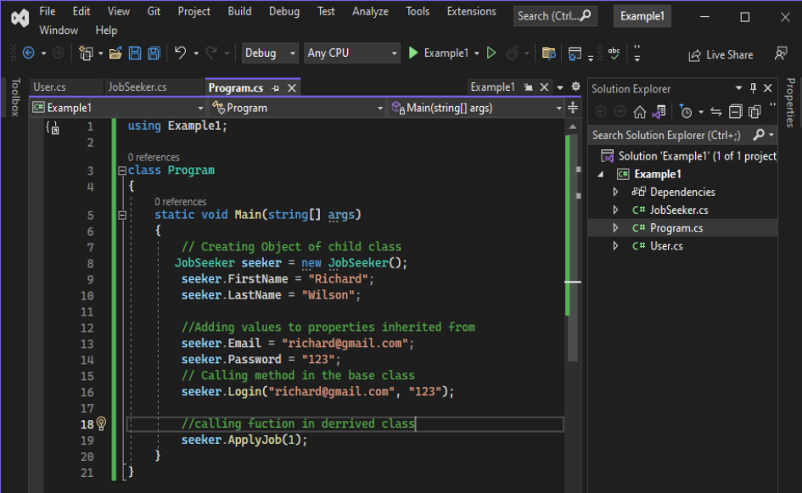
EXAMPLE :

Slide 13
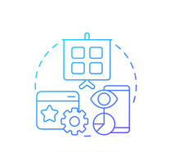
Abstraction
Abstraction is the practice of reducing details so that someone can focus on a few concepts at a time
Abstraction is "To represent the essential feature without representing the background details.“
Abstraction is the process of hiding the working style of an object, and showing the information of an object in an understandable manner.

Slide 14
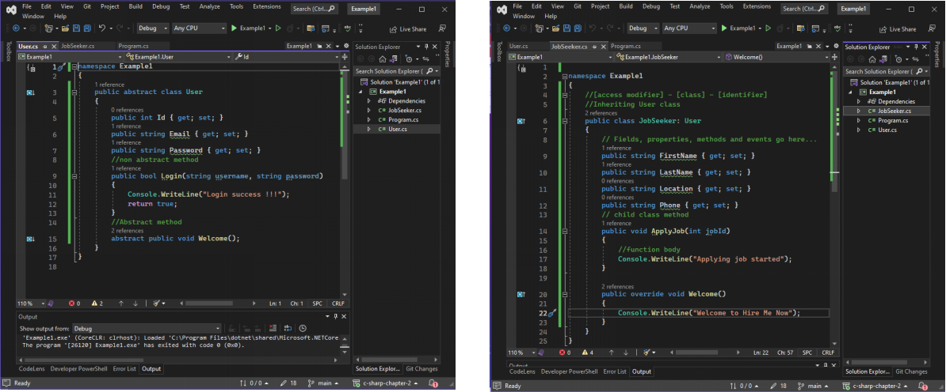
EXAMPLE :

Slide 15
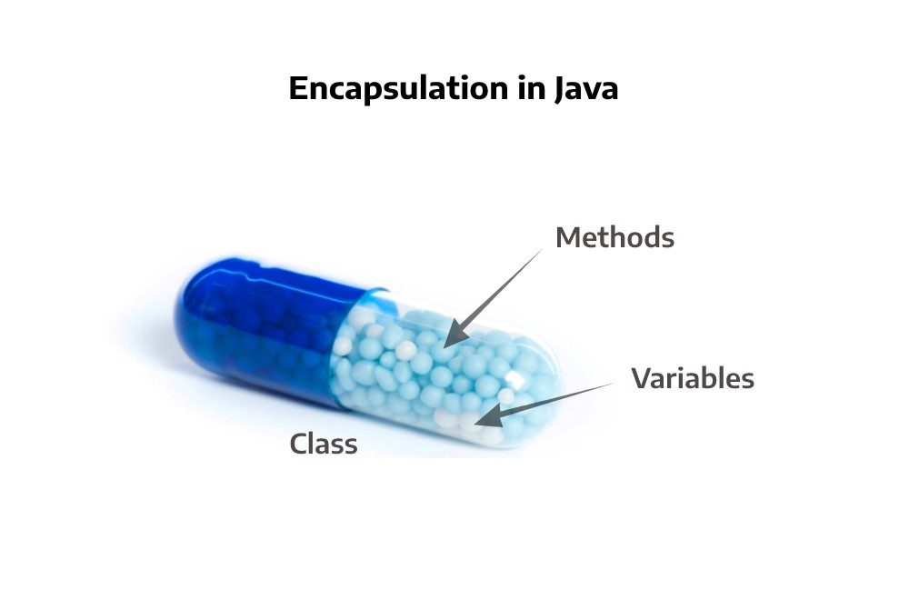
Encapsulation
Encapsulation Hiding the internal state and functionality of an object and only allowing access through a public set of functions..
Think of encapsulation as a black box; data is sent to a method, a lot of work goes on using the data, of which you don't know or care about. An output is returned to the caller. That is the process of encapsulation, or information hiding.
Encapsulation guarantees the integrity of the data contained in the object by preventing users from changing internal data into something invalid.

Slide 16
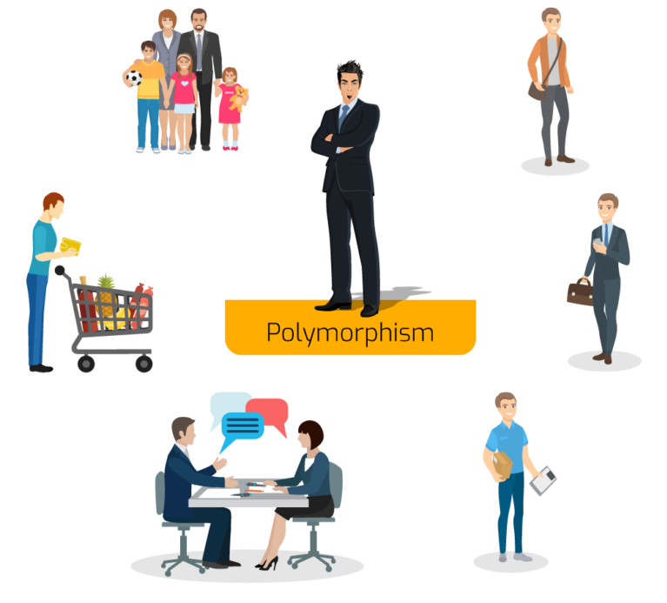
Polymorphism
The Word polymorphism comes from Greek and means having several different forms.
An object behaves differently at different place is called polymorphism.
Polymorphism is briefly described as "one interface, many implementations.
polymorphism can be achieved through method overloading and method overriding.

Slide 17
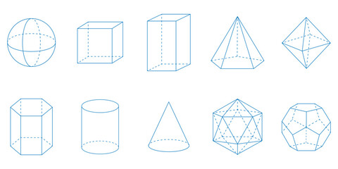
Method Overloading
Same method with different signature (number or type of arguments)

Slide 18
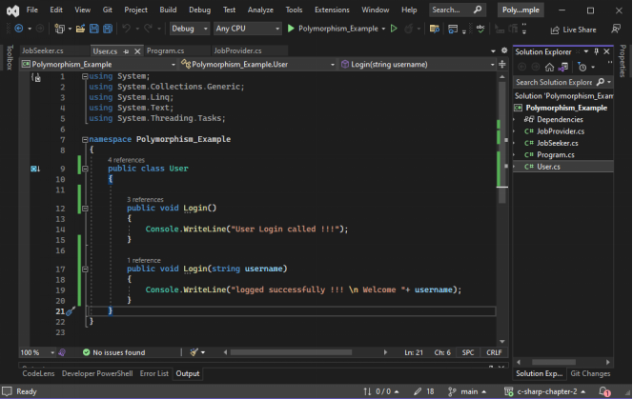
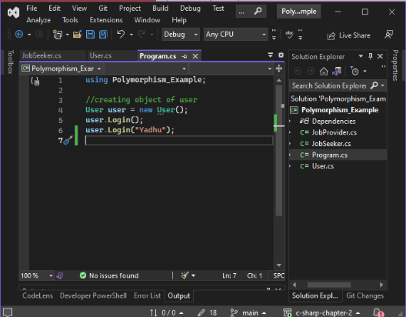
EXAMPLE :

Slide 19
METHOD OVERRIDING
In a class hierarchy, when a method in a subclass has the same name and type signature as a method in its super class, then the method in the subclass is said to override the method in the super class.

Slide 20
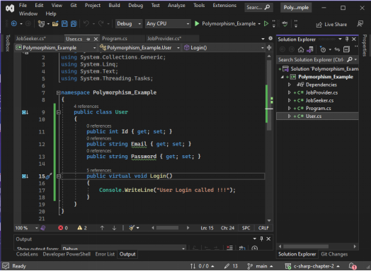
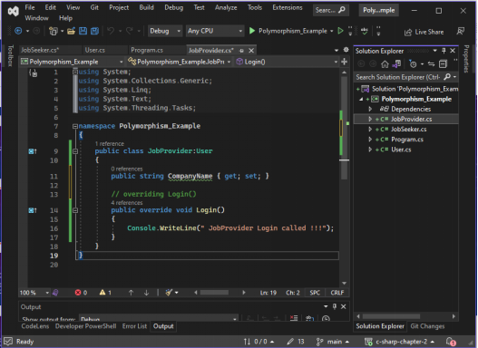
EXAMPLE :

Slide 21
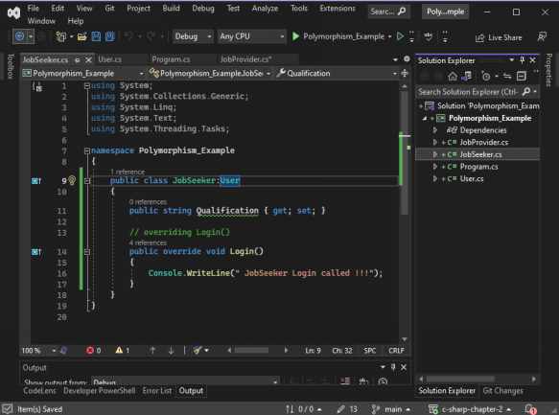
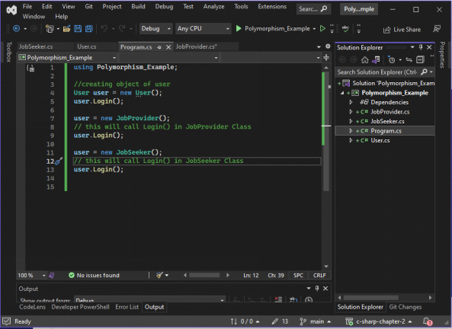
EXAMPLE :

Slide 22
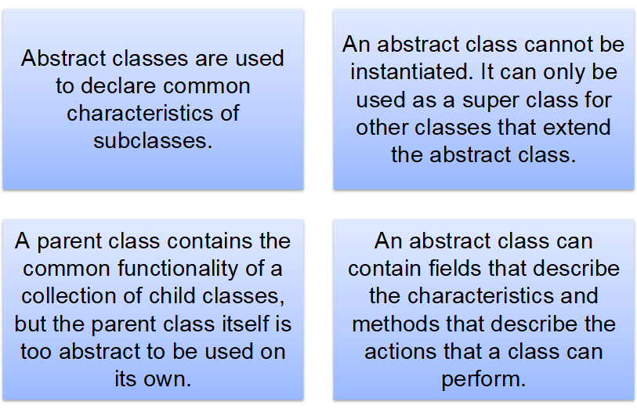
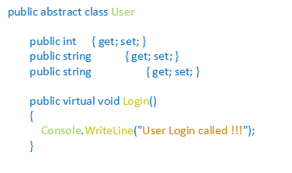
Abstract class

Slide 23
Interface
Interface can be used to define a generic template and then one or more abstract classes to define partial implementations of the interface.
Interfaces just specify the method declaration. The method in the interface is implemented in the subclasses.
Interface definition begins with the keyword interface. An interface like that of an abstract class cannot be instantiated.
Using interfaces we can implement multiple Inheritance

Slide 24
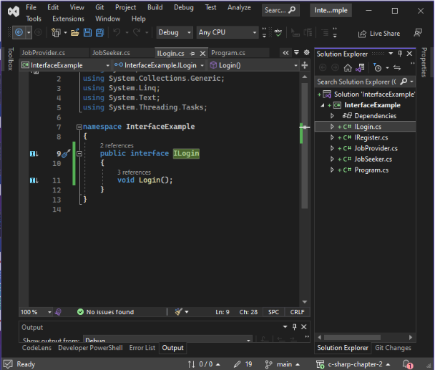
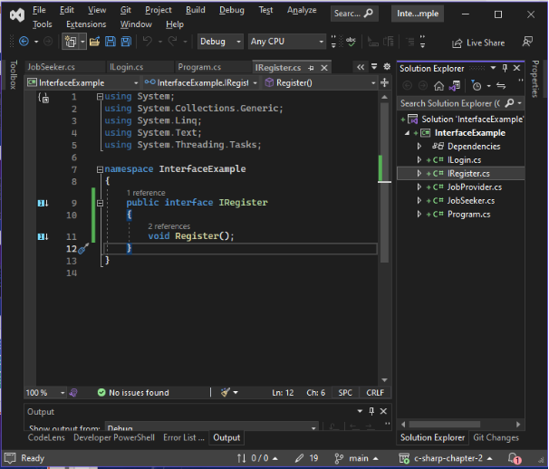
EXAMPLE :

Slide 25
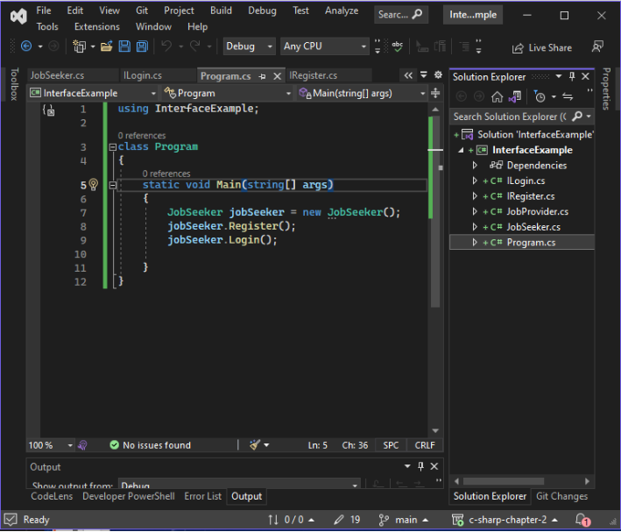
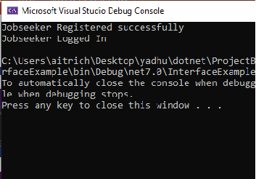
EXAMPLE :

Slide 26

Thank you

